Slide 1
CSCE 313 – Unix fork and exec and the programming interface
Reading Reference:
Textbook: Chapter 3
Molay Reference Text: Chapter 8
Aakash Tyagi CSCE 313 Spring 2016
February 9, 2016

Slide 2
Key Learnings from 2/4
Concept and Definition of a Process
Example viewed through UNIX ‘ps’
Outlined some questions about processes for forthcoming discussions
Process concurrency and context switching
Process A
code
Process B
code
Process A
Process B
Process C
user code
kernel code
context switch
Time
Time
user code
kernel code
context switch
user code

Slide 3
Theme of Today’s Lecture
Talk a bit about Unix Shell
Introduce some key process control concepts
Executing a program from within a program
Creating a new process
Introducing Wait dependencies between parent and child processes

Slide 4
What is a Shell?
Shell is a program which
Runs programs
Manages inputs and outputs
Can be programmed

Slide 5
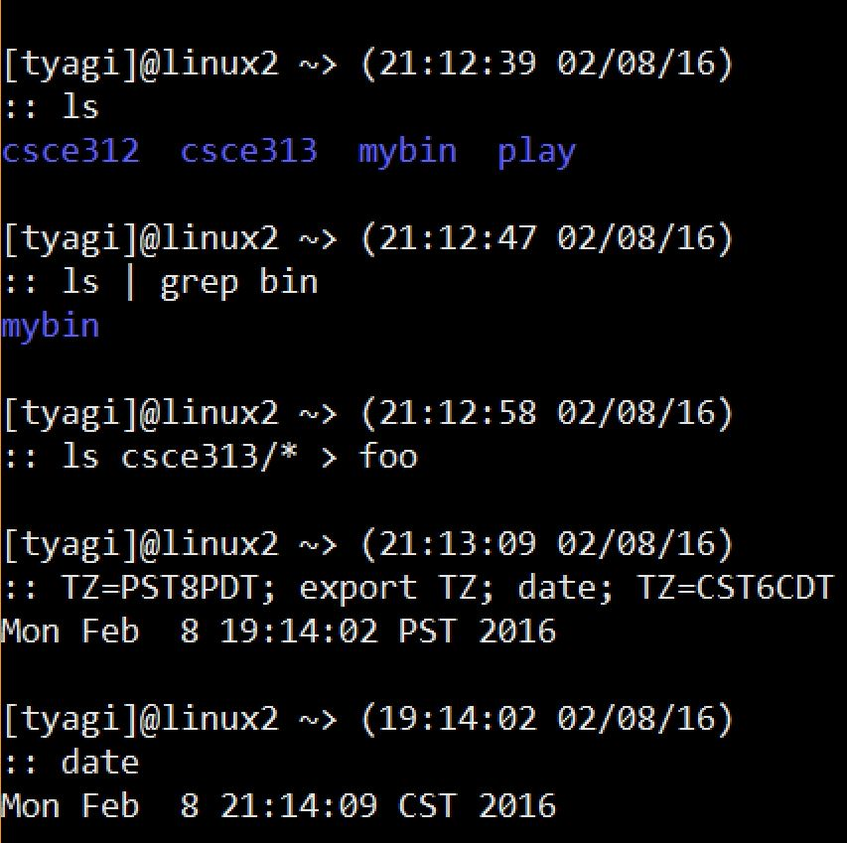
Shell – Running Programs
The commands ls, grep, date, etc. are regular programs. The shell loads these programs into memory and runs them.

Slide 6
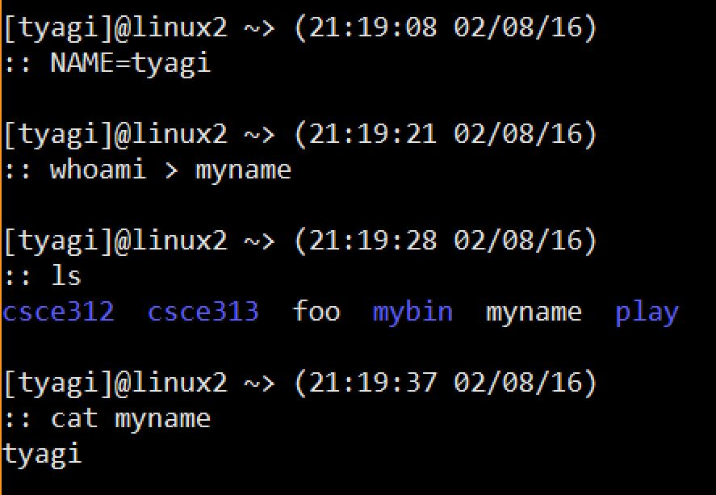
Shell – Managing I/O
Using ‘>’, ‘|’ etc. the user tells the shell to attach the output to a file on disk, or to another process, etc.

Slide 7
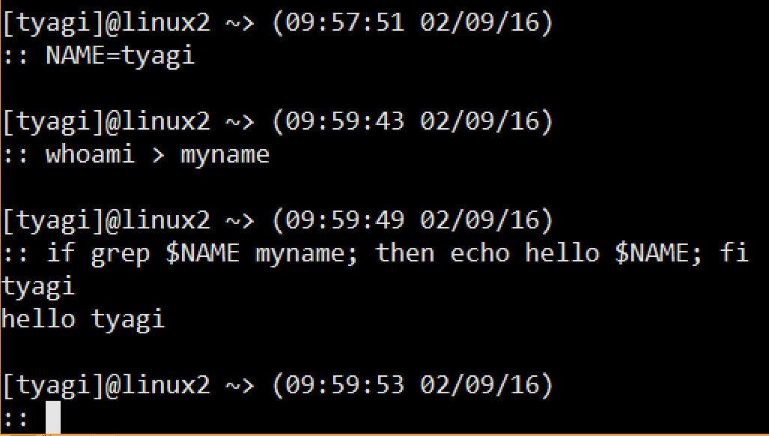
Shell - Programming
Shell is also a programming language with variables and flow control

Slide 8

How does the Shell Run Programs?
A. The user types a.out in the shell
D
B
$ a.out
New process
Shell
B. The shell creates a new process to run the program
C. The shell load the program
from the disk into the memory
process mgmt.
system
C
D. The program runs in its process until it is done
A
program
User
Ref: Understanding Unix/Linux Programming by Bruce Molay

Slide 9
The Main Loop of a Shell
The shell consists of the following loop:
while (! end_of_input)
get command
execute command
wait for command to finish
Ref: Understanding Unix/Linux Programming by Bruce Molay

Slide 10
To Write a Shell, we need to…
Run a Program
Create a Process
Wait for Exit

Slide 11

How does a Program run a Program?
Process (Program) calls “execvp”
Kernel loads program from disk into the process
Kernel copies arglist into the process
Kernel calls main(argc, argv)
process
1
3
array of strings
2
program to run

Slide 12
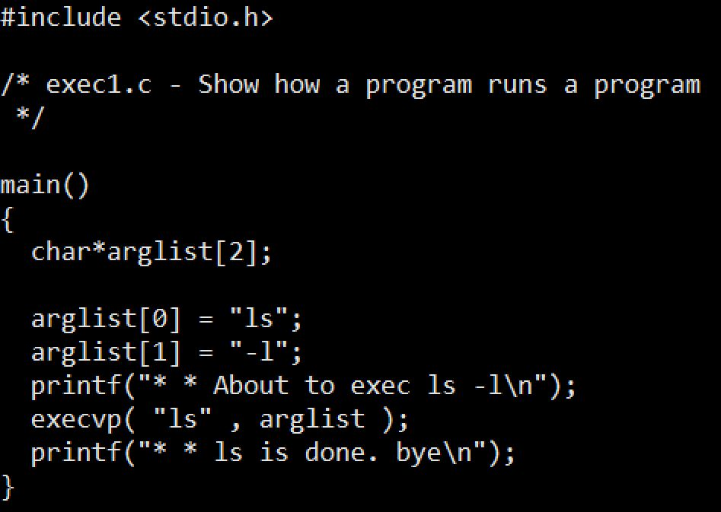
Example: Program running a program

Slide 13
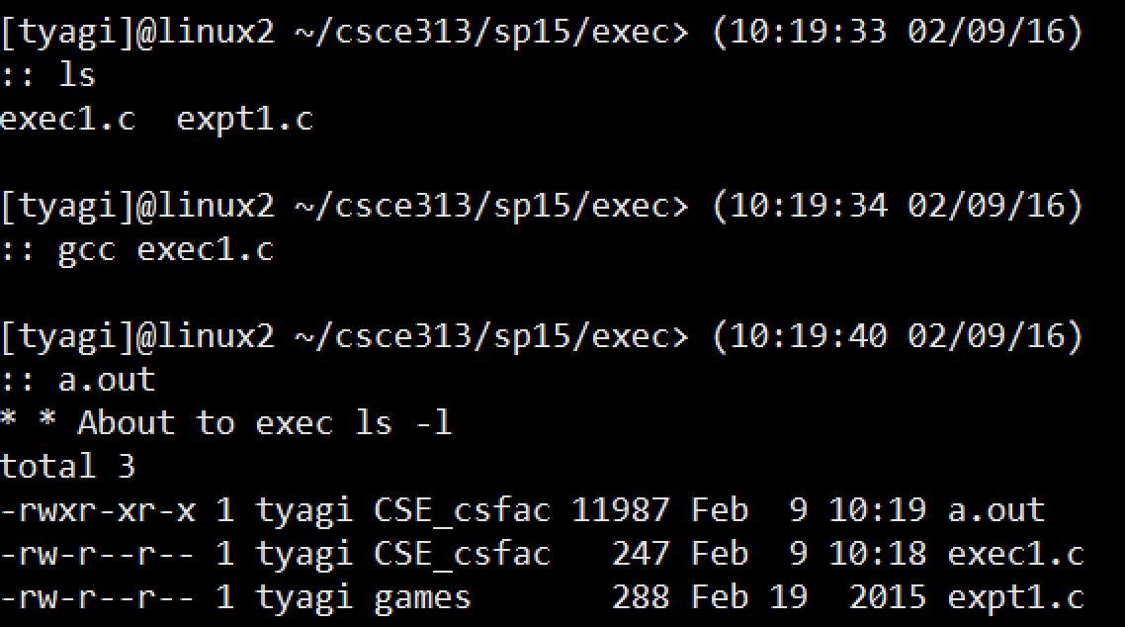
Example: contd.

Slide 14
Example: contd.
Where is the second message?
The exec system call clears out the machine language code of the current program from the current process and then in the now empty process puts the code of the program named in the exec call and then runs the new program
execvp does not return if it succeeds
execvp is like a brain transplant
Notes:
Reference: http://linux.about.com/library/cmd/blcmdl3_execvp.htm
Linux / Unix Command: execvp Command LibraryNAME
execl, execlp, execle, execv, execvp - execute a file SYNOPSIS
#include <unistd.h>extern char **environ;
int execl(const char *path, const char *arg, ...); int execlp(const char *file, const char *arg, ...); int execle(const char *path, const char *arg , ..., char * const envp[]); int execv(const char *path, char *const argv[]); int execvp(const char *file, char *const argv[]);
DESCRIPTION
The exec family of functions replaces the current process image with a new process image. The functions described in this manual page are front-ends for the function execve(2). (See the manual page for execve for detailed information about the replacement of the current process.)The initial argument for these functions is the pathname of a file which is to be executed.
The const char *arg and subsequent ellipses in the execl, execlp, and execle functions can be thought of as arg0, arg1, ..., argn. Together they describe a list of one or more pointers to null-terminated strings that represent the argument list available to the executed program. The first argument, by convention, should point to the file name associated with the file being executed. The list of arguments must be terminated by a NULL pointer.
The execv and execvp functions provide an array of pointers to null-terminated strings that represent the argument list available to the new program. The first argument, by convention, should point to the file name associated with the file being executed. The array of pointers mustbe terminated by a NULL pointer.
The execle function also specifies the environment of the executed process by following theNULL pointer that terminates the list of arguments in the parameter list or the pointer to the argv array with an additional parameter. This additional parameter is an array of pointers to null-terminated strings and must be terminated by a NULL pointer. The other functions take the environment for the new process image from the external variable environ in the current process.
Some of these functions have special semantics.
The functions execlp and execvp will duplicate the actions of the shell in searching for an executable file if the specified file name does not contain a slash (/) character. The search path is the path specified in the environment by the PATH variable. If this variable isn't specified, the default path ``:/bin:/usr/bin'' is used. In addition, certain errors are treated specially.
If permission is denied for a file (the attempted execve returned EACCES), these functions will continue searching the rest of the search path. If no other file is found, however, they will return with the global variable errno set to EACCES.
If the header of a file isn't recognized (the attempted execve returned ENOEXEC), these functions will execute the shell with the path of the file as its first argument. (If this attempt fails, no further searching is done.)
RETURN VALUE
If any of the exec functions returns, an error will have occurred. The return value is -1, and the global variable errno will be set to indicate the error.

Slide 15
How do we get a new process?
A process calls FORK to replicate itself
Usage: fork (); /* takes no arguments*/
After a process invokes fork, control passes to the KERNEL. The Kernel does this:
Allocates address space and data structures
Copies the original process into the new process
Adds the new process to the set of running processes
Returns control back to both processes
User
Parent process
Child process
User
Before
fork()
After
Before
fork()
After
Before
fork()
After
Kernel
fork
fork
Kernel
Before Fork
After Fork

Slide 16
How do we get a new process?
A process calls FORK to replicate itself
Usage: fork (); /* takes no arguments*/
After a process invokes fork, control passes to the KERNEL. The Kernel does this:
Allocates address space and data structures
Copies the original process into the new process
Adds the new process to the set of running processes
Returns control back to both processes
Parent process
Child process
User
Before
fork()
After
Before
fork()
After
fork
Kernel
After Fork

Slide 17
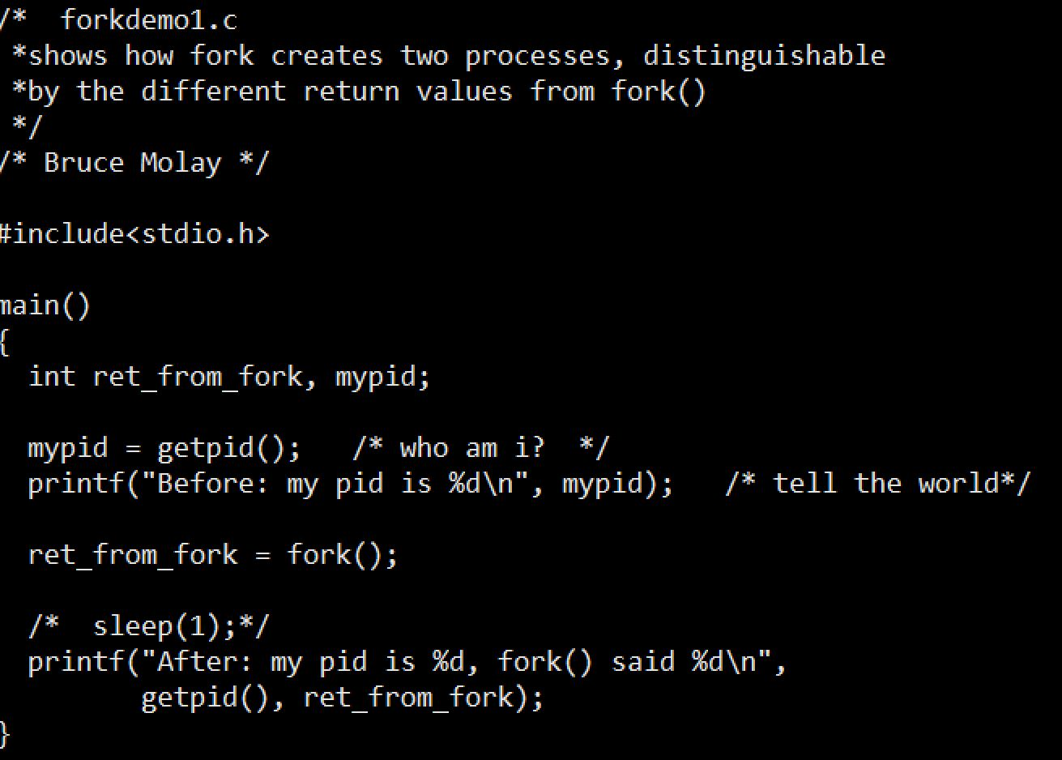
Example: Fork

Slide 18
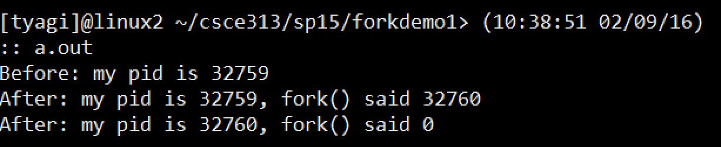
Example: Fork
Why is the “After” message printed twice but “Before” message only once?
Because Fork created a child process and both parent and child execute the rest of the code following the fork

Slide 19
Example: Fork
Why is the “After” message printed twice but “Before” message only once?
Parent process
Child process
Before
fork()
After
Before
fork()
After
Before
fork()
After
fork
fork
Before Fork
After Fork

Slide 20
wait: Synchronizing With Children
int wait(int *child_status)
Suspends current process until one of its children terminates
Return value is pid of child process that terminated
If child_status != NULL, then integer it points to will be set to indicate why child terminated

Slide 21
wait: Synchronizing With Children
Void wait_demo() {
int child_status;
if (fork() == 0) {
printf("HC: hello from child\n");
}
else {
printf("HP: hello from parent\n");
wait(&child_status);
printf("CT: child has terminated\n");
}
printf("Bye\n");
exit(0);
}
HC
Bye
HP
CT
Bye

Slide 22
Some questions to ponder about processes
How is a process created?
How is a process deleted?
Is there a user process and kernel process
Where do we keep information about a process
Does a process have to run through completion from start to finish or can it be interrupted?
Do processes have priorities?
What are the relationships between multiple processes in a system?
Can we have multiple processes related to the same program? Would multiple processes of the same program share addresses during execution?
How does a program run a program?
How does a parent wait for a child to exit?

Slide 23
Key Learnings
Shell Basics
Replacing Program Executed by Process
Call execv (or variant)
One call, (normally) no return
Spawning Processes
Call to fork
One call, two returns
Reaping Processes
Call wait

Slide 24
Next Lecture
More about process fork, exec, and new functions related to process data and control
How many lines will be printed? Assume parent process id is 1000, what would be the output of this program? Will it always be the same?

